Slide 1
CSE331
Automata and computability
Introduction to Turing Machines
Summer 2026

Slide 2
Today's learning goals Sipser Ch 2, 3.1
Identify sets of strings as regular, context-free, or neither.
Relate key differences between DFA, NFA, PDA, Turing machines and computational power.
Trace the computation of a Turing machine using its transition function and configurations.
Determine when a Turing machine is a decider.

Slide 3
Informal intuition
There must be at least one language that is not context-free
Which specific language is not context-free?
{ 0^{n}1^{m}0^{n} | m,n≥0 }
{ 0^{n}1^{n}0^{n} | n≥0 }
{ 0^{n}1^{2n} | n≥0 }
{ 0^{n}1^{2m} | m,n≥0 }
I don't know.

Slide 4
Examples of non-context-free languages
{ a^{n}b^{n}c^{n} | 0 ≤ n } Sipser Ex 2.36
{ a^{i}b^{j}c^{k} | 0 ≤ i ≤ j ≤ k } Sipser Ex 2.37
{ w w | w is in {0,1}* } Sipser Ex 2.38
To prove… Pumping lemma for CFLs (won't cover in class)

Slide 5
Closure ?
The class of regular languages is closed under
Union
Concatenation
Star
Complementation
Intersection
Difference
Reversal
The class of context-free languages is closed under
Union
Concatenation
Star
Reversal
The class of context-free languages is not closed under
Intersection
Complement
Difference

Slide 6
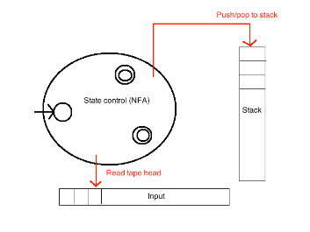

???
Context-free languages
???
Regular languages

Slide 7
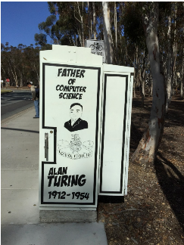
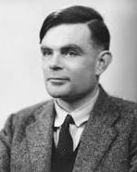
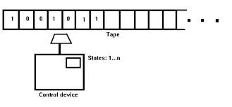
Turing machines
Unlimited input
Unlimited (read/write) memory
Unlimited time

Slide 8

The imitation game
A movie about Turing and his role in
breaking the Enigma code in WWII
He made many inventions, one of them
is the “Turing machine”
https://www.youtube.com/watch?v=eWq5wAX8K8A

Slide 9
Turing machine computation
Read/write head starts at leftmost position on tape
Input string written on leftmost squares of tape, rest is blank
Computation proceeds according to transition function:
  Given current state of machine, and current symbol being read
  the machine
    transitions to new state
    writes a symbol to its current position (overwriting existing symbol)
    moves the tape head L or R
Computation ends if and when it enters either the accept or the reject state.

Slide 10
Language of a Turing machine
L(M) = { w | computation of M on w halts after entering the accept state}
i.e. L(M) = { w | w is accepted by M}
Comparing TMs and PDAs, which of the following is true:
Both TMs and PDAs may accept a string before reading all of it.
A TM may only read symbols, whereas a PDA may write to its stack.
Both TMs and PDAs must read the string from left to right.
States in a PDA must be either accepting or rejecting, but in a TM may be neither.
I don't know.

Slide 11
Why is this model relevant?
Division between program (CPU, state space) and data (memory) is a cornerstone of all modern computing
Unbounded memory is outer limits of what modern computers (PCs, quantum computers, DNA computers) can implement.
Simple enough to reason about (and diagonalize against), expressive enough to capture modern computation.

Slide 12
An example
L = { w#w | w is in {0,1}* }
We already know that L is
not regular
not context-free
We will prove that L is
the language of some Turing machine

Slide 13
An example
L = { w#w | w is in {0,1}* }
Idea for Turing machine
Zig-zag across tape to corresponding positions on either side of '#' to check whether these positions agree. If they do not, or if there is no '#', reject. If they do, cross them off.
Once all symbols to the left of the '#' are crossed off, check for any symbols to the right of '#': if there are any, reject; if there aren't, accept.

Slide 14
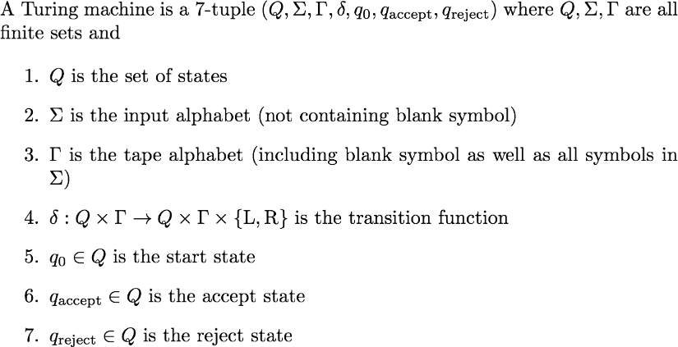
Formal definition of TM
q_{reject} ≠ q_{accept}

Slide 15
Formal definition of TM
Are Turing machines deterministic or not?
Deterministic
Nondetermistic
Can be either
I don't know

Slide 16
Language of a TM Sipser p. 144
L(M) = { w | M accepts w}
= { w | there is a sequence of configurations of M
where C₁ is start configuration of M on input w,
each C_{i} yields C_{i+1} and C_{k} is accepting configuration}
"The language of M"
"The language recognized by M"

Slide 17
Deciders and recognizers Sipser p. 144 Defs 3.5 and 3.6
L is Turing-recognizable if some Turing machine recognizes it.
M is a decider TM if it halts on all inputs.
L is Turing-decidable if some Turing machine that is a decider recognizes it.

Slide 18
An example
L = { w#w | w is in {0,1}* }
We already know that L is
not regular
not context-free
We will prove that L is
the language of some Turing machine Turing-decidable
(hence also Turing-recognizable)

Slide 19
An example
L = { w#w | w is in {0,1}* }
Idea for Turing machine
Zig-zag across tape to corresponding positions on either side of '#' to check whether these positions agree. If they do not, or if there is no '#', reject. If they do, cross them off.
Once all symbols to the left of the '#' are crossed off, check for any symbols to the right of '#': if there are any, reject; if there aren't, accept.

Slide 20
An example
Is this machine a decider?
Yes, because it reads the input string exactly once.
Yes, because it will halt (and either accept or reject) no matter what the input is.
No, because it sometimes rejects the input string.
No, because it will go in an infinite loop if there's no '#'.
I don't know.
L = { w#w | w is in {0,1}* }
Idea for Turing machine
Zig-zag across tape to corresponding positions on either side of '#' to check whether these positions agree. If they do not, or if there is no '#', reject. If they do, cross them off.
Once all symbols to the left of the '#' are crossed off, check for any symbols to the right of '#': if there are any, reject; if there aren't, accept.

Slide 21
An example
L = { w#w | w is in {0,1}* }
Idea for Turing machine
Zig-zag across tape to corresponding positions on either side of '#' to check whether these positions agree. If they do not, or if there is no '#', reject. If they do, cross them off.
Once all symbols to the left of the '#' are crossed off, check for any symbols to the right of '#': if there are any, reject; if there aren't, accept.
How would you use this machine to prove that L is decidable?

Slide 22
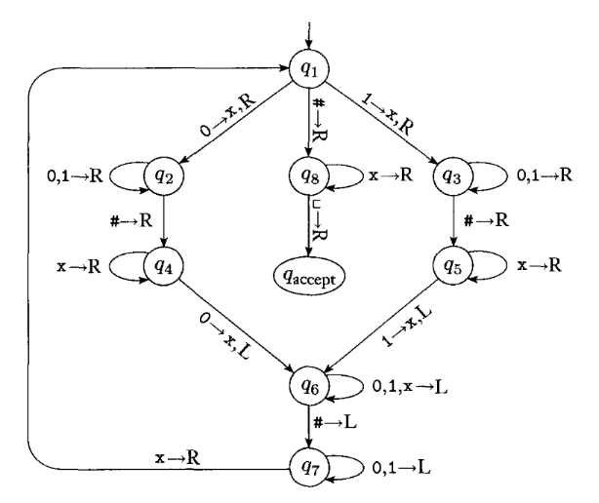
Q={q1,q2,q3,q4,q5,q6,q7,q8,q_{accept},q_{reject}}
Σ = {0,1,#}
Γ = {0,1,#,x,_ }
All missing transitions have output (q_{reject}, _, R)
Fig 3.10 in Sipser

Slide 23
Configurations of a TM
Current state
Current tape contents
Current location of read/write head
u q v
current state is q
current tape contents are uv (and then all blanks)
current head location is first symbol of v

Slide 24
Configurations of a TM
Start configuration on w:
q₀ w
Accepting configuration:
u q_{acc} v
Rejecting configuration:
u q_{rej} v
Halting configuration: any configuration that is either accepting or rejecting.
Current state
Current tape contents
Current location of read/write head
u q v
current state is q
current tape contents are uv (and then all blanks)
current head location is first symbol of v

Slide 25
Transitioning between configurations
q₀ w
w is input, read/write head over the leftmost symbol of w
u q v
q' = δ(q, v₁)
How does uv compare to u'v'?
u' q' v'

Slide 26
Computation on input 0#0?
Configuration u q v
for current tape uv (and then all blanks), current head location is first symbol of v, current state q

Slide 27
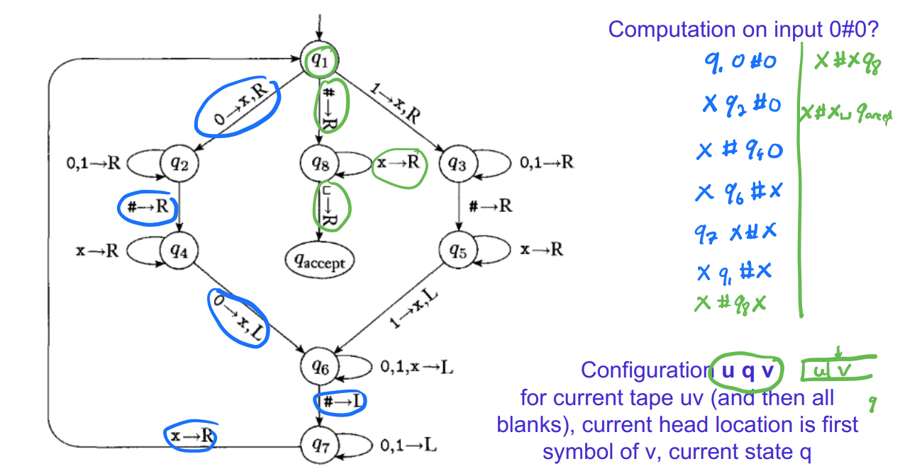
Computation on input 0#0?
Configuration u q v
for current tape uv (and then all blanks), current head location is first symbol of v, current state q

Slide 28
Computation on input 0# ?
Configuration u q v
for current tape uv (and then all blanks), current head location is first symbol of v, current state q

Slide 29
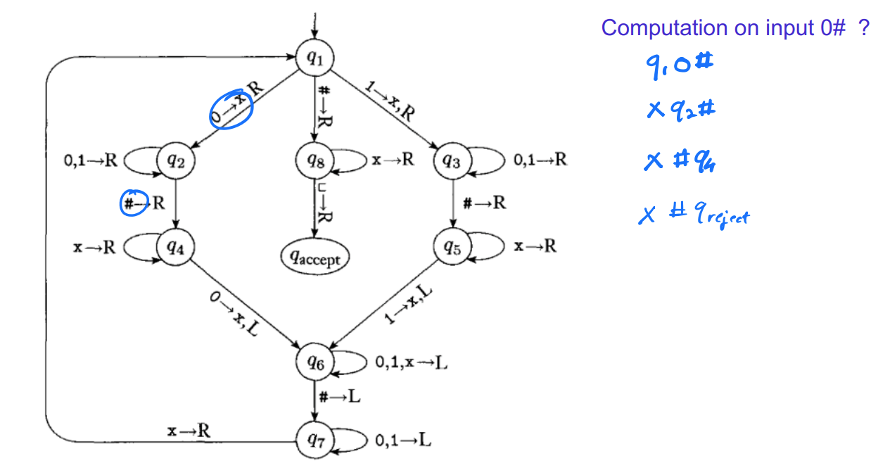
Computation on input 0# ?
Configuration u q v
for current tape uv (and then all blanks), current head location is first symbol of v, current state q

Slide 30
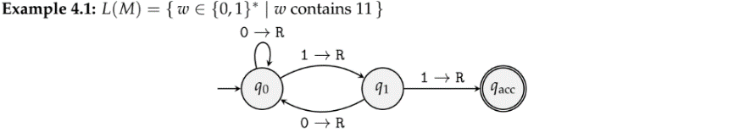
Example

Slide 31
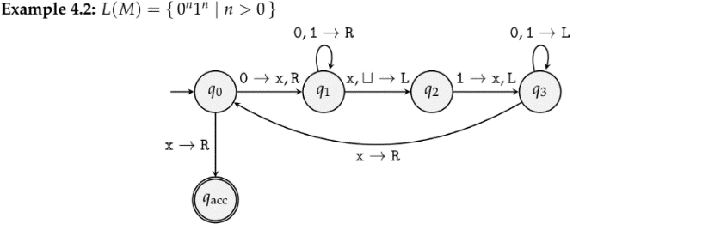
Example

